Slide 1
Association of two variables

Slide 2
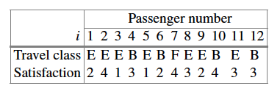
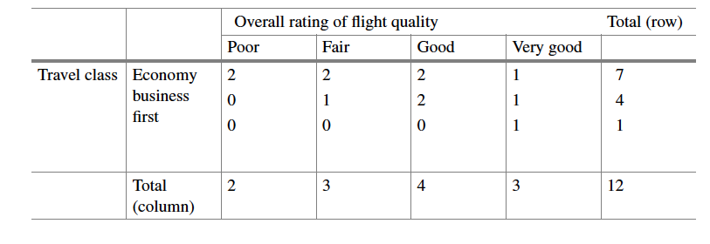
Summarising distribution of two discrete variables: contingency table
survey
contingency
table

Slide 3
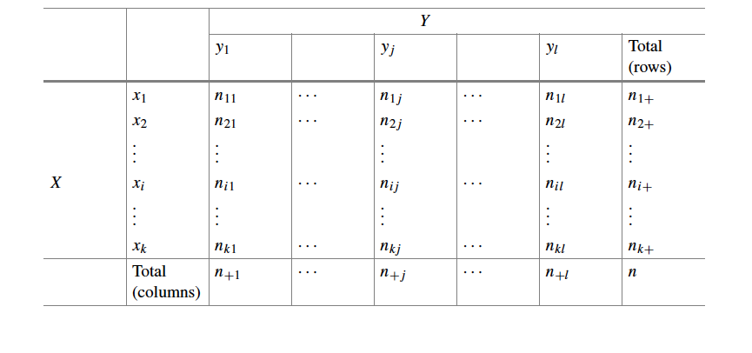
General contingency table

Slide 4
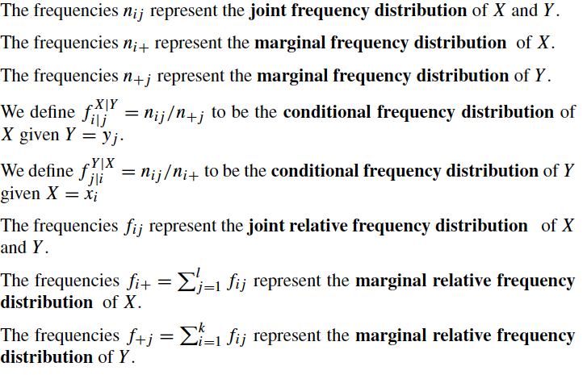

Slide 5
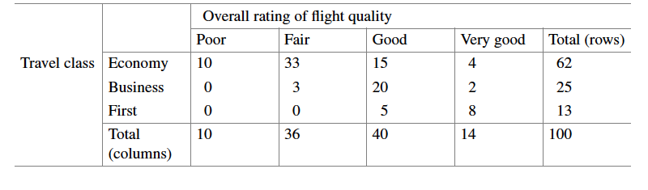



16% of passengers flying economy rate the flight quality as poor.
37.5% of passengers who rated the flight quality as good were flying economy.

Slide 6
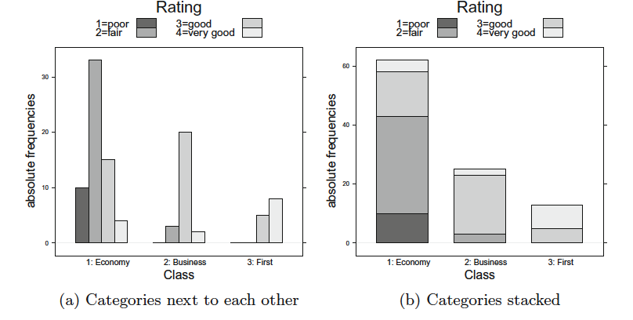
Graphical representation of two nominal or ordinal variables

Slide 7

Independent variables
Two variables are considered independent if the observations on one variable do not affect the observations on the other variable (e.g. two persons rolling a die separately).
If two variables are independent, then:

Slide 8
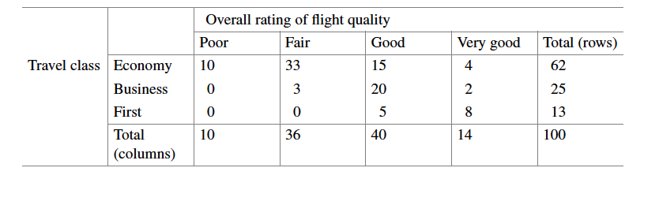
Independent variables
Two variables are considered independent if the observations on one variable do not affect the observations on the other variable (e.g. two persons rolling a die separately).
If two variables are independent, then:

Slide 9
Independent variables
Two variables are considered independent if the observations on one variable do not affect the observations on the other variable (e.g. two persons rolling a die separately).
If two variables are independent, then:
expected

Slide 10
Independent variables
Two variables are considered independent if the observations on one variable do not affect the observations on the other variable (e.g. two persons rolling a die separately).
If two variables are independent, then:
expected
observed

Slide 11

Independent variables
Two variables are considered independent if the observations on one variable do not affect the observations on the other variable (e.g. two persons rolling a die separately).
If two variables are independent, then:

Slide 12
Independent variables
Two variables are considered independent if the observations on one variable do not affect the observations on the other variable (e.g. two persons rolling a die separately).
If two variables are independent, then:
Expected relative frequency
Expected absolute frequency

Slide 13
Measures of association of two discrete variables
When two variables are not independent, we say they are associated.
Measures of association describe the strength of association, and they can have a direction too (except for nominal variables).

Slide 14



Pearson’s $χ^{2}$statistic
for k x l contingency table
It measures the deviation from independence: the stronger the relationship between the variables, the higher the deviations between observed and expected frequencies under independence assumption.
Range of possible values

Slide 15
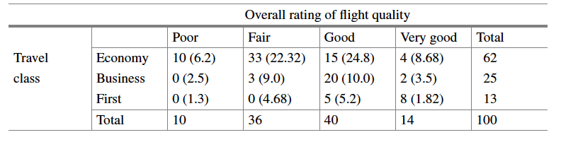
Example

Slide 16
Example

Slide 17
Example

Slide 18
Example
Interpretation: moderate association between travel class and overall rating of flight quality.

Slide 19



Cramer’s V statistic
Pearson’s $χ^{2}$ coefficient has the main disadvantage that the range of its maximum value depends on sample size and size of contingency table.
Cramer’s V statistic is a standardised version of Pearson’s $χ^{2}$ coefficient with maximal value 1. The closer V gets to 1, the stronger the association between the variables.

Slide 20
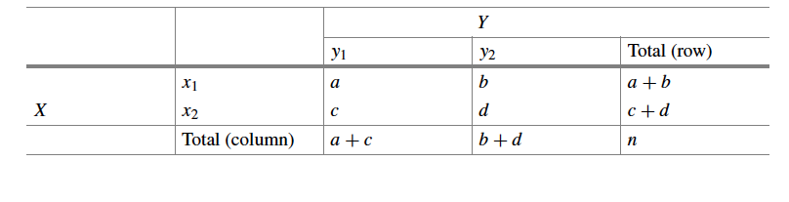


Relative risks
relative risks

Slide 21
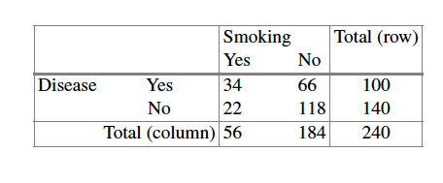

Relative risks: example
The proportion of individuals with the disease is 1.69 times higher among smokers.

Slide 22

Relative risks: example
The proportion of individuals with the disease is 1.69 times higher among smokers.
The proportion of healthy individuals is 0.61 times smaller among smokers.

Slide 23

Odds ratio
odds ratio

Slide 24
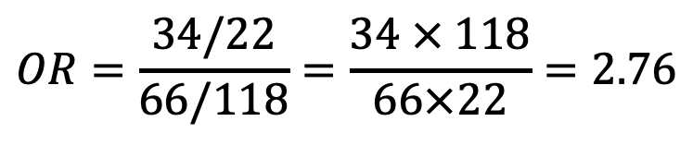
Odds ratio: example
$$OR=\frac{34/22}{66/118}=\frac{34 × 118}{66×22}=2.76$$
The chances of having the disease is 2.76 times higher for smokers compared to non-smokers.

Slide 25
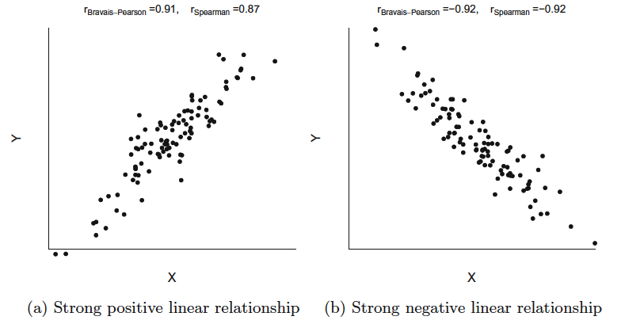
Association between continuous variables: scatter plots

Slide 26
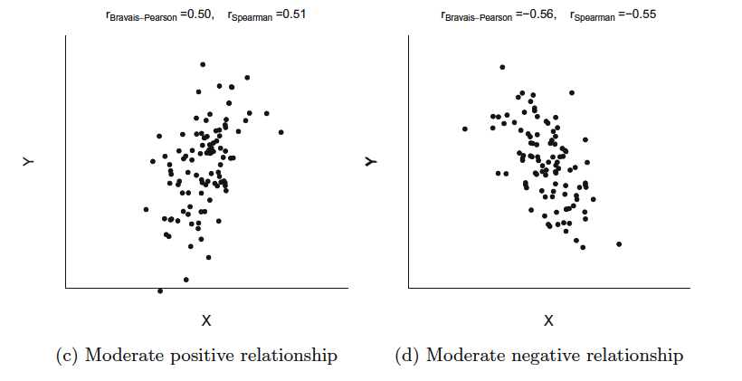
Association between continuous variables: scatter plots

Slide 27
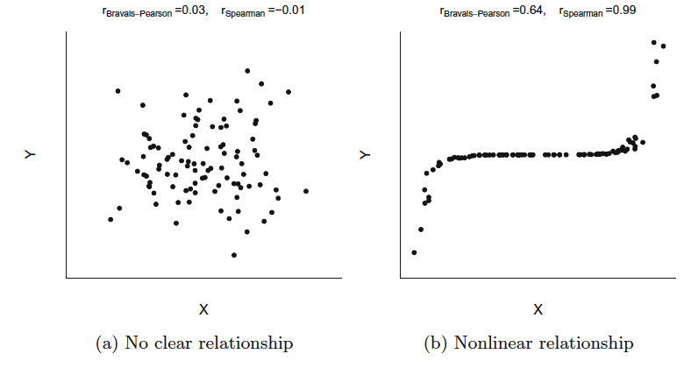
Association between continuous variables: scatter plots

Slide 28
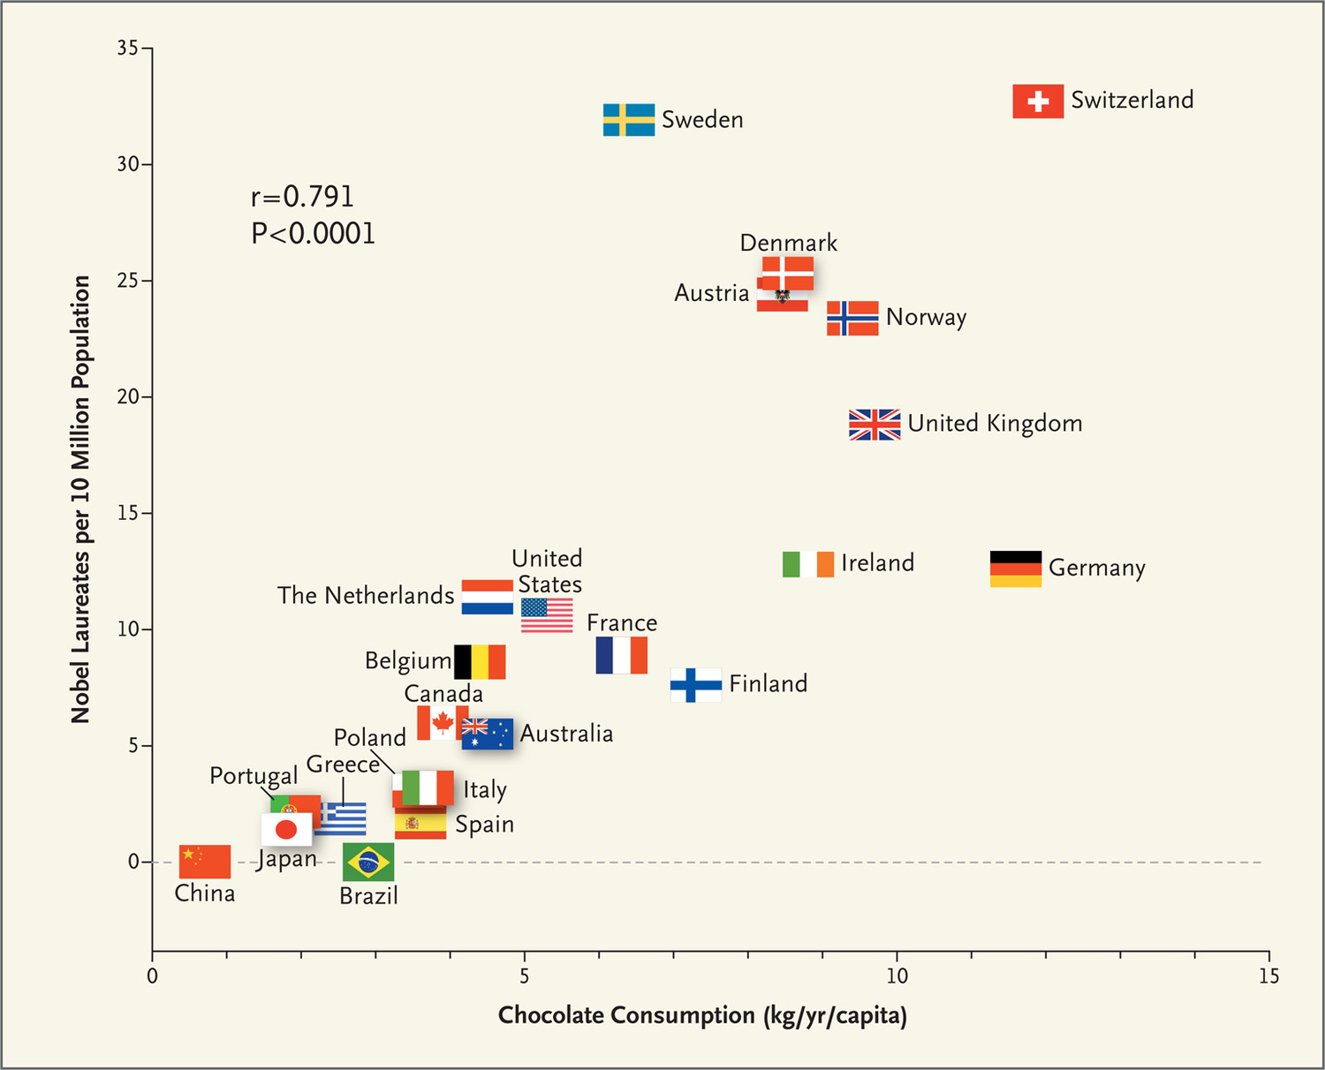

Slide 30
Correlation ≠ Causation

Slide 31
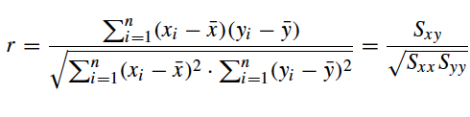
Bravais-Pearson correlation coefficient

Slide 32


Bravais-Pearson correlation coefficient

Slide 33
Bravais-Pearson correlation coefficient
It measures the degree of linear relationship between the variables X and Y.
It is dimensionless (no units).
Result independent of units used to measure variables X and Y.
Limits of r: -1≤r ≤1
Perfect linear relationship (Y=a+bX) → r=1 (if b>0) or r=-1 (if b<0).
Sign of r indicates direction of association.
If r is close to 0, either X and Y are independent or the relationship between X and Y is not linear.

Slide 34
Spearman’s rank correlation coefficient
The talent competition:
2 different judges mark and then rank the participants of the competition according to their performance (the worst participant is assigned rank 1, the second worst is assigned rank 2, etc).
How can we measure the degree of agreement between the judges?

Slide 35

Spearman’s rank correlation coefficient
Rank of i^{th} participant given by the 1st judge
Rank of i^{th} participant given by the 2nd judge

Slide 36

Spearman’s rank correlation coefficient
Rank of i^{th} observation of variable X
Rank of i^{th} observation of variable Y

Slide 37

Spearman’s rank correlation coefficient
Rank of i^{th} observation of variable X
Rank of i^{th} observation of variable Y
Spearman’s rank correlation coefficient

Slide 38

Spearman’s rank correlation coefficient
It measures the degree of correlation between the ranks of the variables X and Y.
Values of R are between -1 and 1.
If we change from ascending to descending order, R remains the same.
If two or more observations take the same value (tie), their corresponding ranks are simply averaged. For example, if 2 participants in the talent competition have obtained the same score, we assign to each of them the rank 1.5 instead of 1 and 2.

Slide 39
Comparison of Bravais-Pearson and Spearman correlation coefficients
Bravais-Pearson can only be applied to continuous variables, but not to ordinal variables.
Spearman can be applied to two continuous variables, two ordinal variables, or to a combination or a continuous and an ordinal variable.
Spearman measures any type of relationship between the variables, whereas Pearson measures only linear relationships.

Slide 40
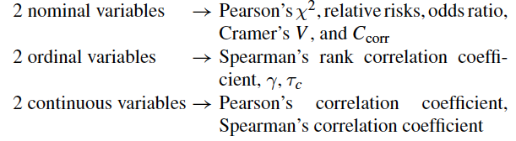
Summary

